Slide 1


COFFEE SALES ANALYSIS USING SQL

Slide 2


HELLO
My name is Sivakumar. In this project I have utilized SQL queries to solve the question those are related to the coffee sales.

Slide 3


OBJECTIVE
This project is all about coffee sales numbers to find out how well the restaurant is doing and what trends there are. I want to use the information to make smarter decisions and plans better for the future

Slide 4
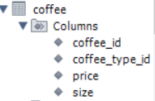
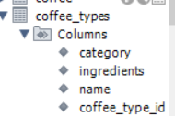

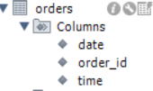
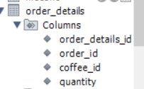
DATA MODEL VIEW

Slide 5
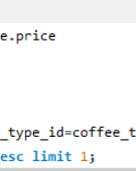
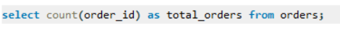

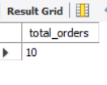
1. RETRIEVE THE TOTAL NUMBER OF ORDERS PLACED

Slide 6
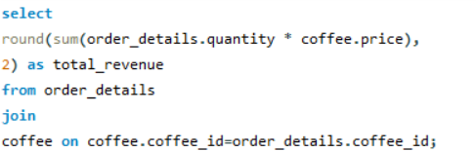

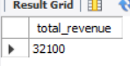
2. CALCULATE THE TOTAL REVENUE GENERATED FROM COFFEE SALES

Slide 7
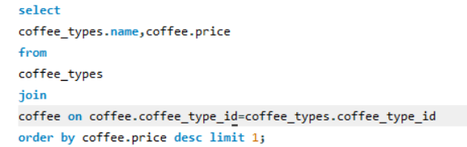

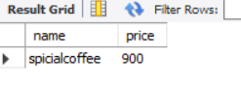
3. IDENTIFY THE HIGHEST-PRICED COFFEE

Slide 8
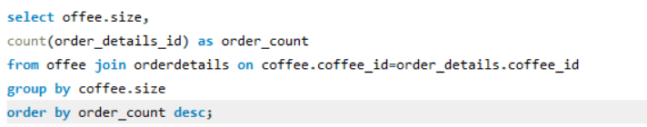
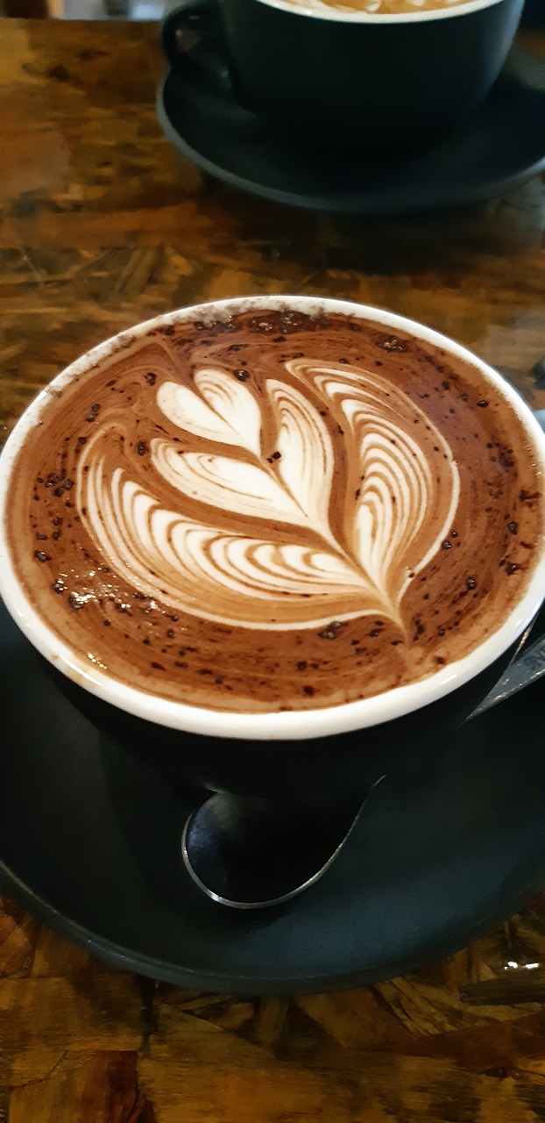
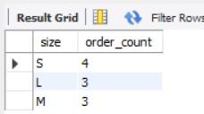
4. IDENTIFY THE MOST COMMON COFFEE SIZE ORDERED

Slide 9
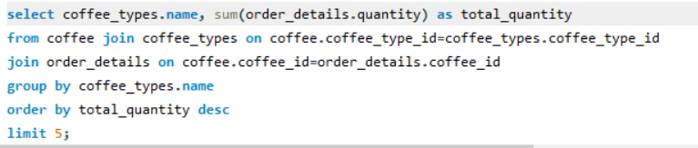

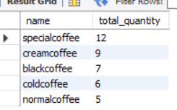
5. LIST THE TOP 5 MOST ORDERED COFFEE TYPES ALONG WITH THEIR QUANTITIES

Slide 10
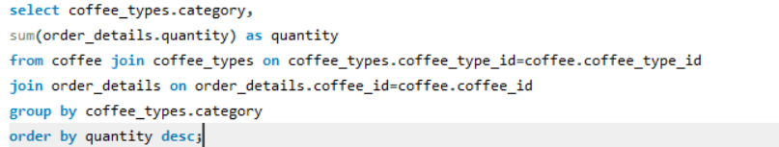

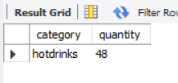
6. JOIN THE NECESSARY TABLE TO FIND TOTAL QUANTITY OF EACH COFFEE CATEGORY ORDERED

Slide 11
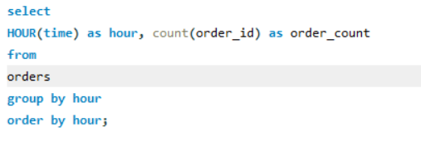

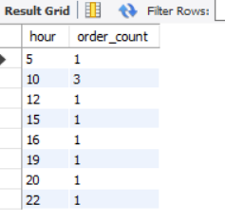
7. Determine the distribution of orders by hour of the day

Slide 12
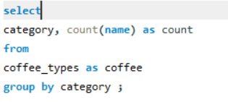

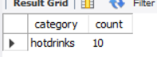
8. JOIN RELEVANT TABLES TO FIND THE CATEGORY-WISE DISTRIBUTION OF COFFEE

Slide 13
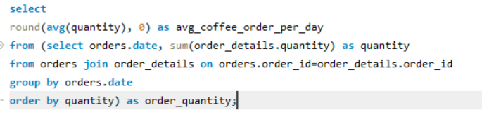
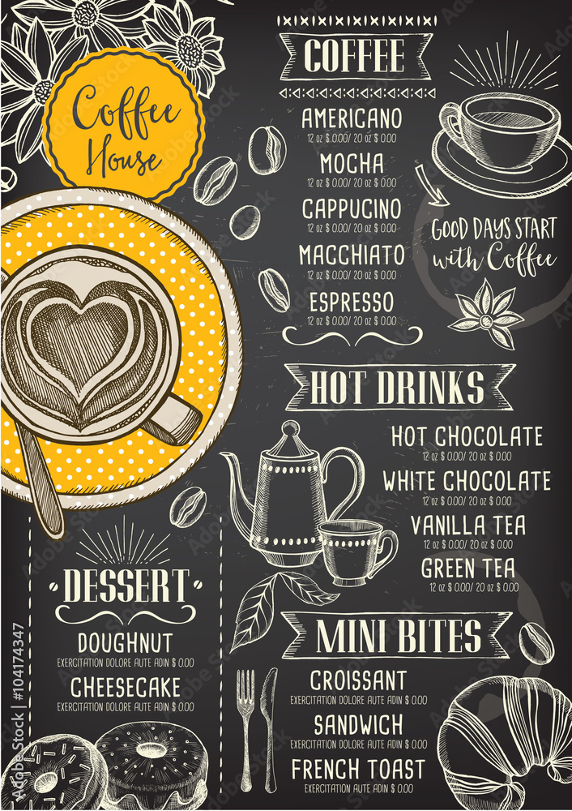
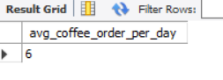
9. GROUP THE ORDERS BY DATE AND CALCULATE THE AVERAGE NUMBER OF COFFEE ORDERS PRE DAY

Slide 14
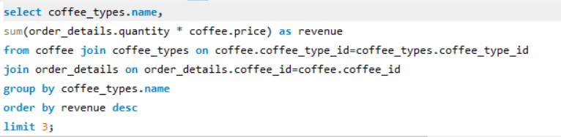
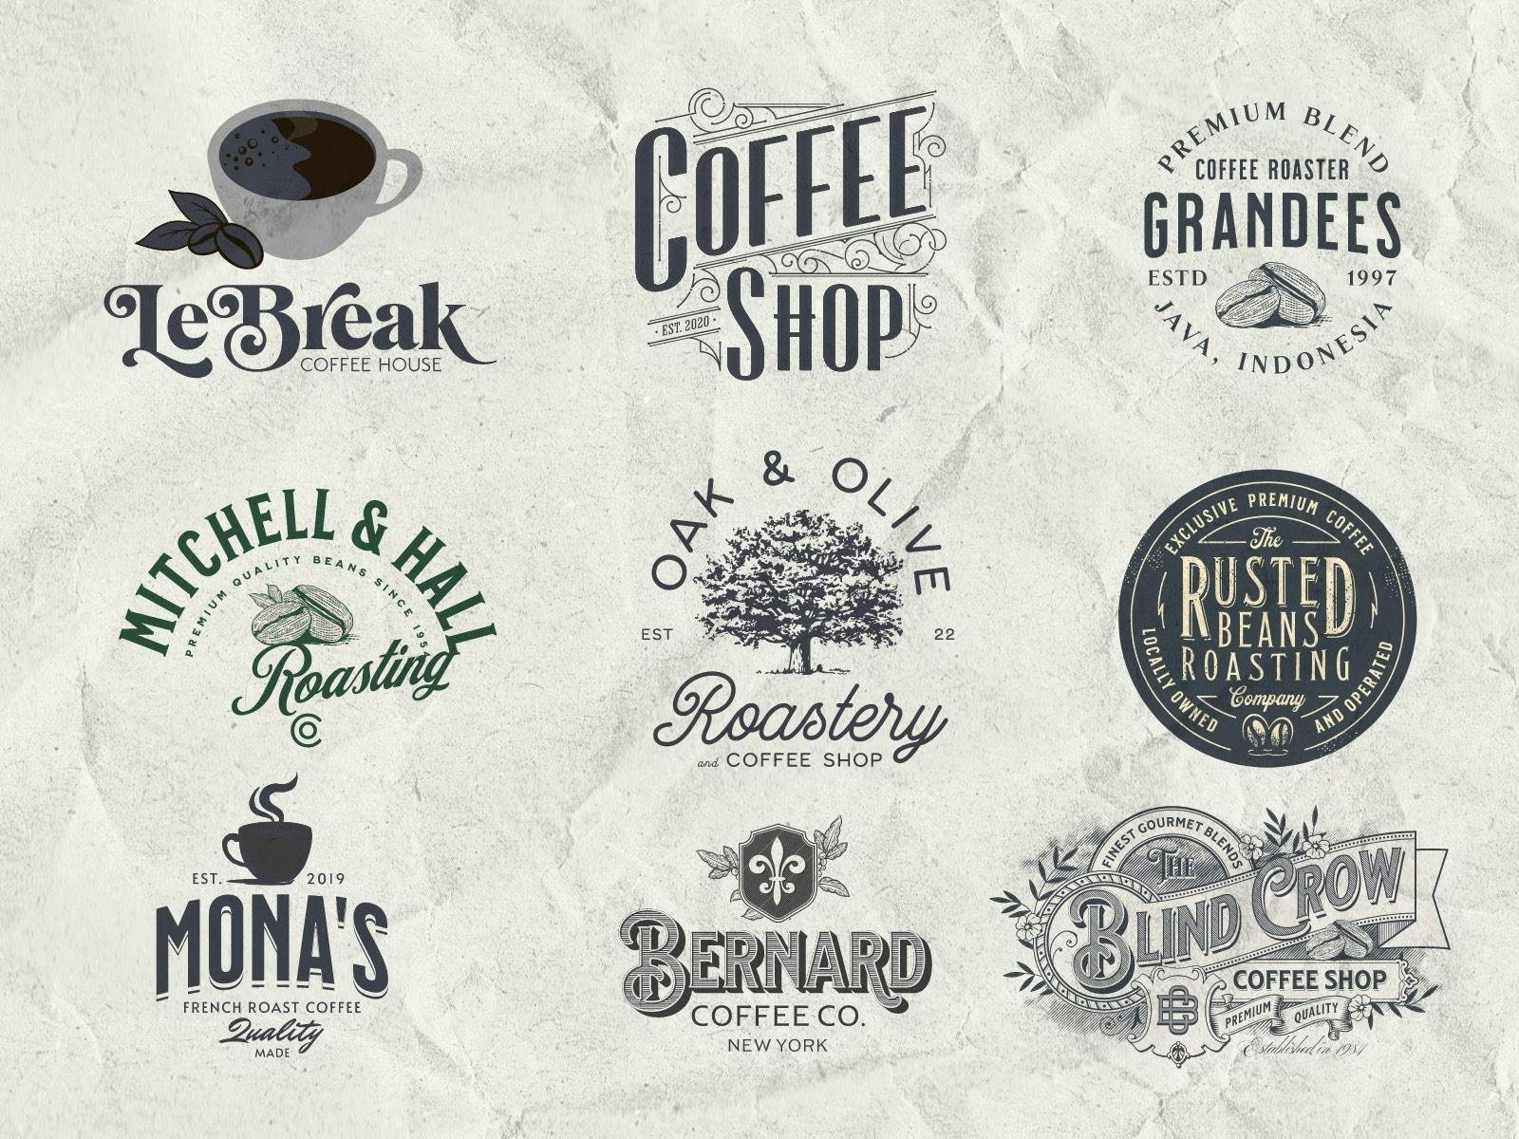
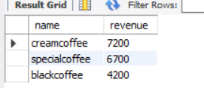
10. DETERMINE THE TOP 3 MOST ORDERED COFFEE TYPES BASED ON REVENUE

Slide 15
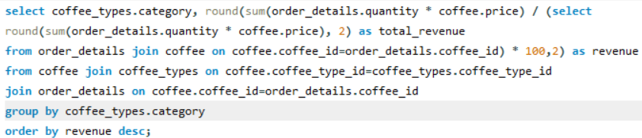

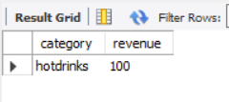
11. CALCULATE THE PERCENTAGE CONTRIBUTION OF EACH COFFEE TYPE TO TOTAL REVENUE

Slide 16
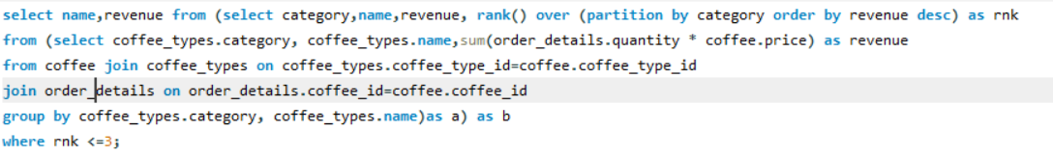
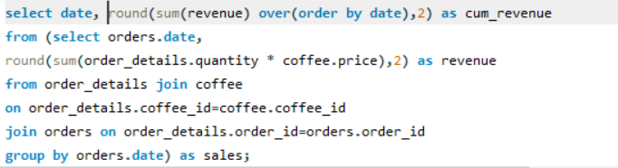

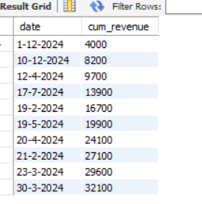
12. ANALYZE THE CUMULATE REVENUE GENERATED OVER TIME

Slide 17

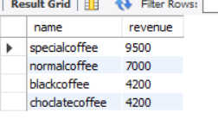
13. DETERMINE THE TOP 3 MOST ORDERED COFFEE TYPE BASED ON REVENUE FOR EACH COFFEE CATEGORY

Slide 18


Thank you
Contact us at
SIVAKUMAR R
sivakumar@fourthcoffee.com
405-555-0145

